Slide 1

“Movie Sales Analytics”
Guguloth Santhosh
Peddi Vamshi Krishna
Batch 403
dilsuknagar

Slide 2
Contents
Introduction
Problem Statement
Objective
Cleaned Data
Visualization
Conclusion

Slide 3

Introduction :
Movie Sales Analytics helps understand how different factors influence a film’s box-office performance.
By analyzing sales trends, audience behavior, budgets, and marketing impact, we can identify what drives movie success.
This presentation highlights key insights that support data-driven decisions for producers, distributors, and investors.

Slide 4
Problem Statement :
Movie sales depend on multiple dynamic factors such as budget, genre, cast popularity, release season, and promotional spending. However, studios often lack a clear understanding of how these components individually and collectively shape box-office outcomes.
This creates difficulty in predicting revenue, allocating budgets efficiently, and designing effective marketing strategies.

Slide 5
Objective :
To analyze box-office performance using historical movie sales data
To identify key factors influencing movie success (budget, cast, genre, marketing, release timing)
To evaluate audience trends and market behavior
To provide insights that help producers and investors make data-driven decisions

Slide 6
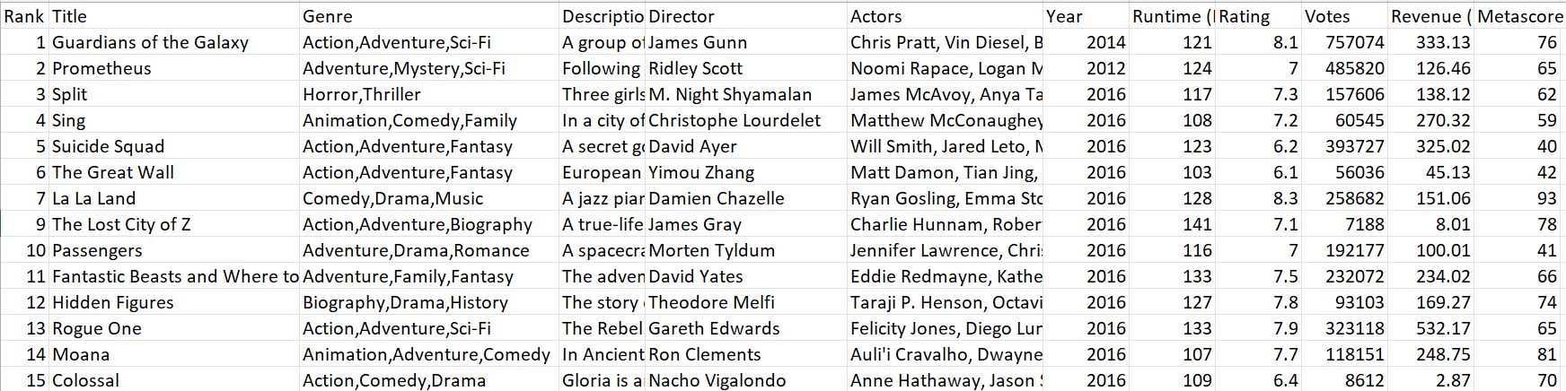
Cleaned Data :

Slide 7
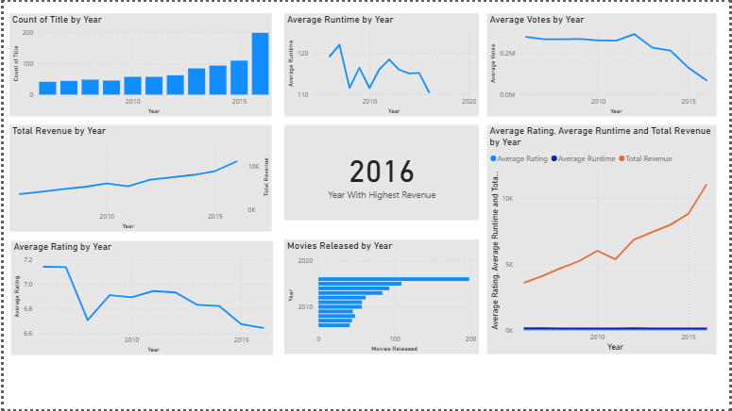
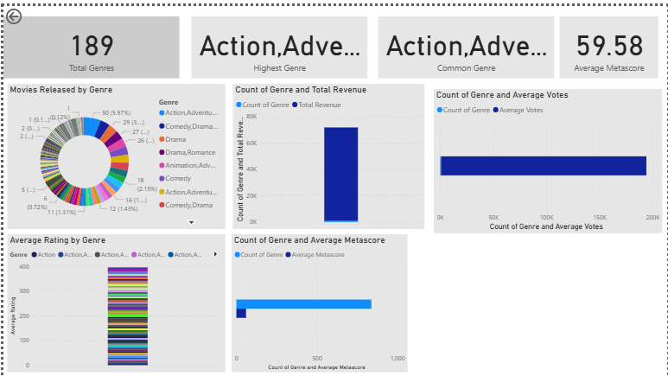
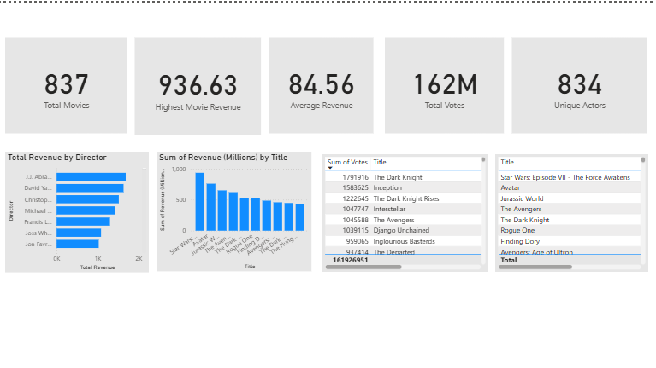
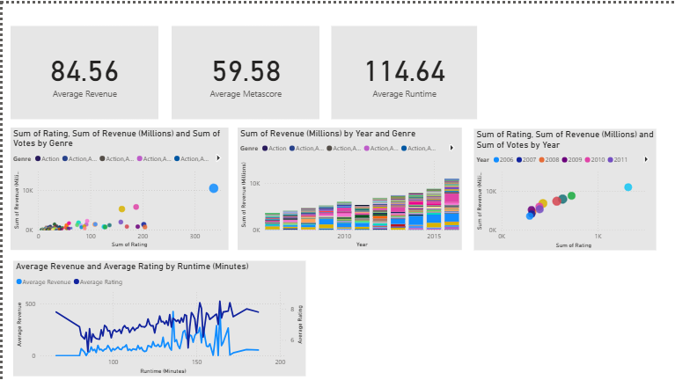

Slide 8
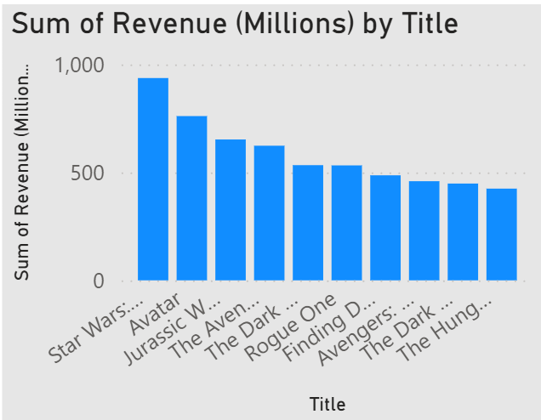
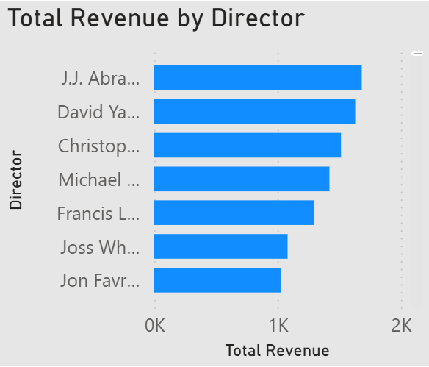
Which movies generated the highest revenue overall?
Insights
Star wars & Avatar movies generate high revenues when compared to other movies
Which directors consistently generate the highest total revenues?
Insights
Abrams Leads the Pack: J.J. Abrams is the top-grossing director shown, just ahead of David Yates.

Slide 9
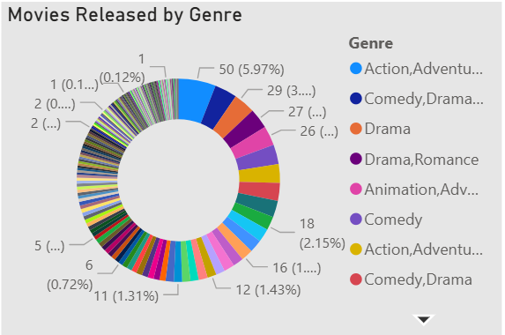
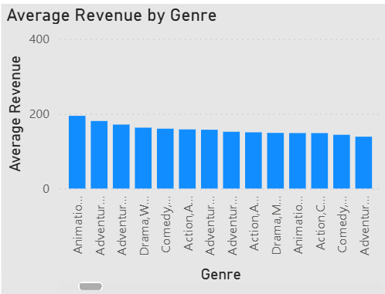
Which genres have the highest number of movies released?
Insights
Action–Adventure is both the highest genre and the most common genre
Which genre generates the highest average revenue?
Insights
Animation movies show the highest average revenue (~190–200).

Slide 10
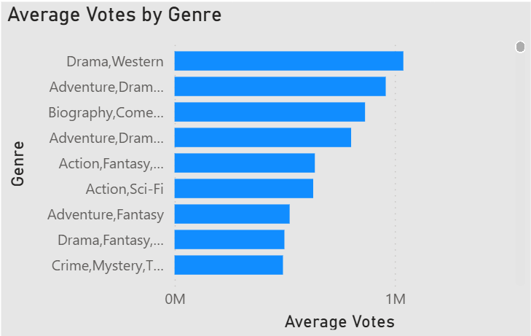
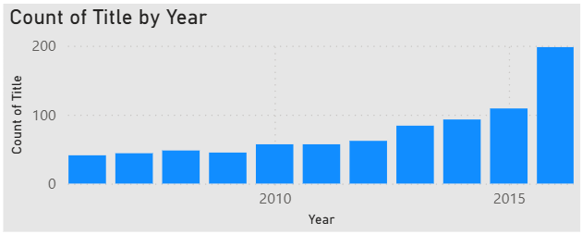
Which genre combination receives the highest number of average votes?
Insights
Drama–Western receives the highest average votes.
Which years shows the most significant percentage increase in the number of titles released ?
Insights
There is a consistent linear growth in the number of titles produced/tracked over the years

Slide 11
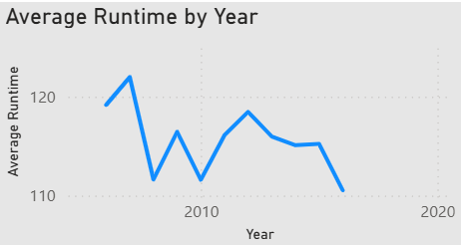
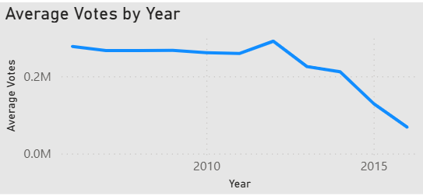
Average Runtime by Year
Insights
The average movie runtime is not stable, fluctuating significantly between approximately 110 minutes and 125 minutes.
Average Votes by Year
Insights
As measured by Average Votes, was highest in the middle of the period (around 2010-2013).

Slide 12
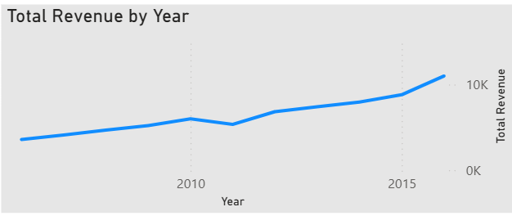
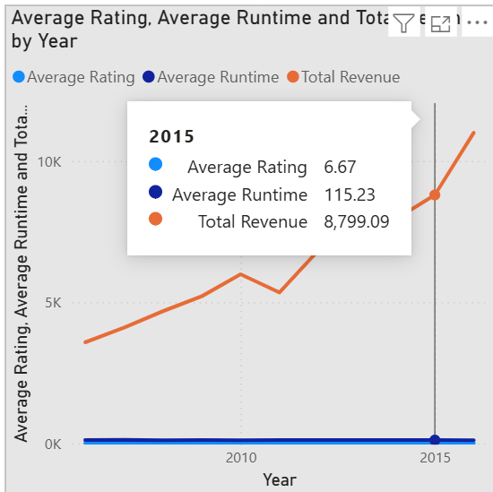
Total Revenue by Year
Insights
The Total Revenue for the industry or dataset showed a strong and consistent upward trend over the entire period
Average Rating, Average Runtime and Total Revenue by Year
Insights
The primary insight is a strong inverse relationship between Average Rating and Total Revenue: financial success is increasing while critical perception is decreasing.

Slide 13
Benefits of Movie Sales Analytics
Improved Revenue Forecasting
Better Budget Allocation
Understanding Audience Behaviour
Optimized Marketing Strategies
Genre & Cast Performance Insights
Data-Driven Release Planning
Reduced Financial Risk

Slide 14
Conclusion :
Movie Sales Analytics enables data-driven decisions that improve the accuracy of revenue forecasting and increase the chances of movie success.

Slide 15

THANK YOU

